Slide 1
ggplot2
Prof. Ashwin Malshe

Slide 2
Components of Layered Grammar
Layers
Layers are responsible for creating the objects that we perceive on the plot
A layer is composed of four parts:
Data and aesthetic mapping
Statistical transformation
Geometric object
Position adjustment

Slide 3
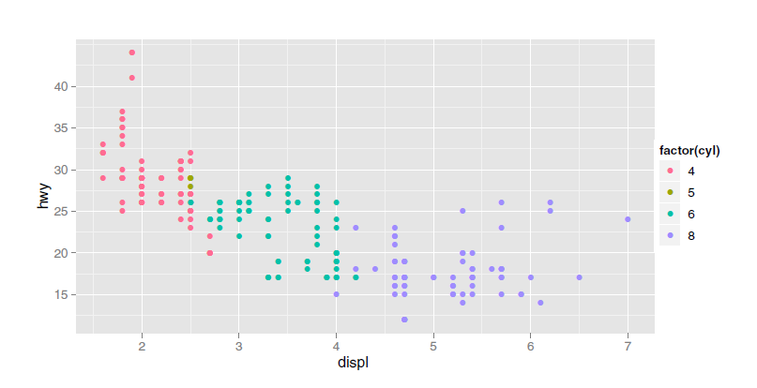
A quick note on aesthetics mapping
Aesthetics are the properties that can be perceived on the graphic. Each aesthetic can be mapped to a variable, or set to a constant value.

Slide 4
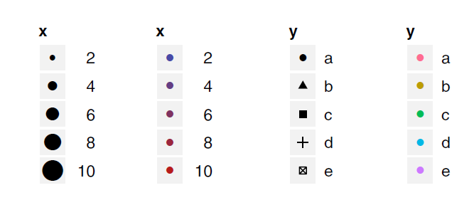
Scales
A scale controls the mapping from data to aesthetic attributes, and we need a scale for every aesthetic used on a plot.
Each scale operates across all the data in the plot, ensuring a consistent mapping from data to aesthetics.
Continuous variable
Discrete variable

Slide 5
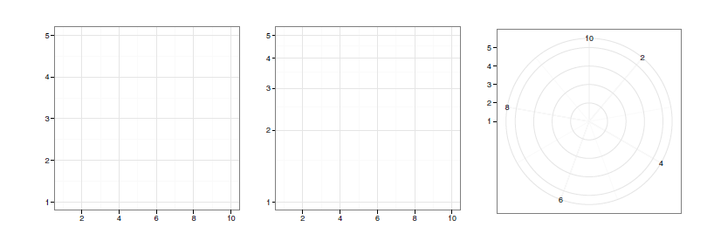
Coordinate system
A coordinate system, or coord for short, maps the position of objects onto the plane of the plot
Position is often specified by two coordinates (x, y)
Coordinate systems control how the axes and grid lines are drawn
Cartesian
Semi-log
Polar

Slide 6
Faceting
This makes it easy to create small multiples each showing a different subset of the whole dataset
This is a powerful tool when investigating whether patterns hold across all conditions
The faceting specification describes which variables should be used to split up the data, and whether position scales should be free or constrained

Slide 7
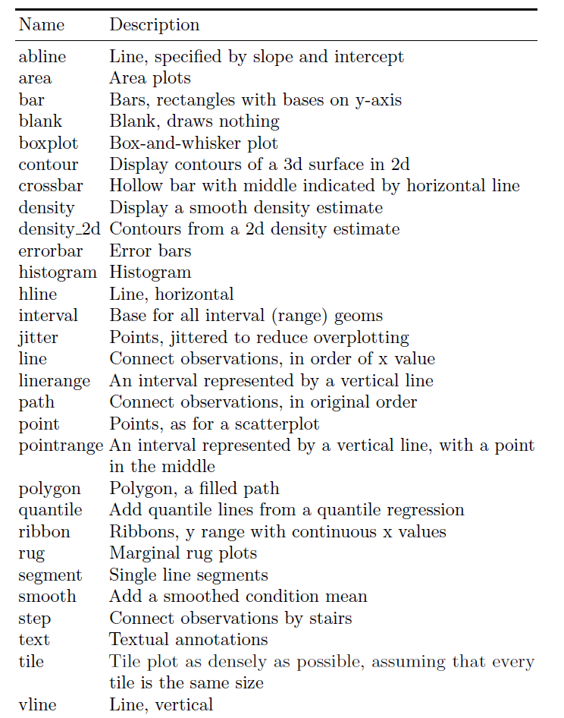
Geoms in ggplot2

Slide 8
